Slide 1

The Drive By Project
Software Manager: Dirk Thieme
Hardware Manager: Erik Manis
Project Controller: Mohammed Ansari

Slide 2
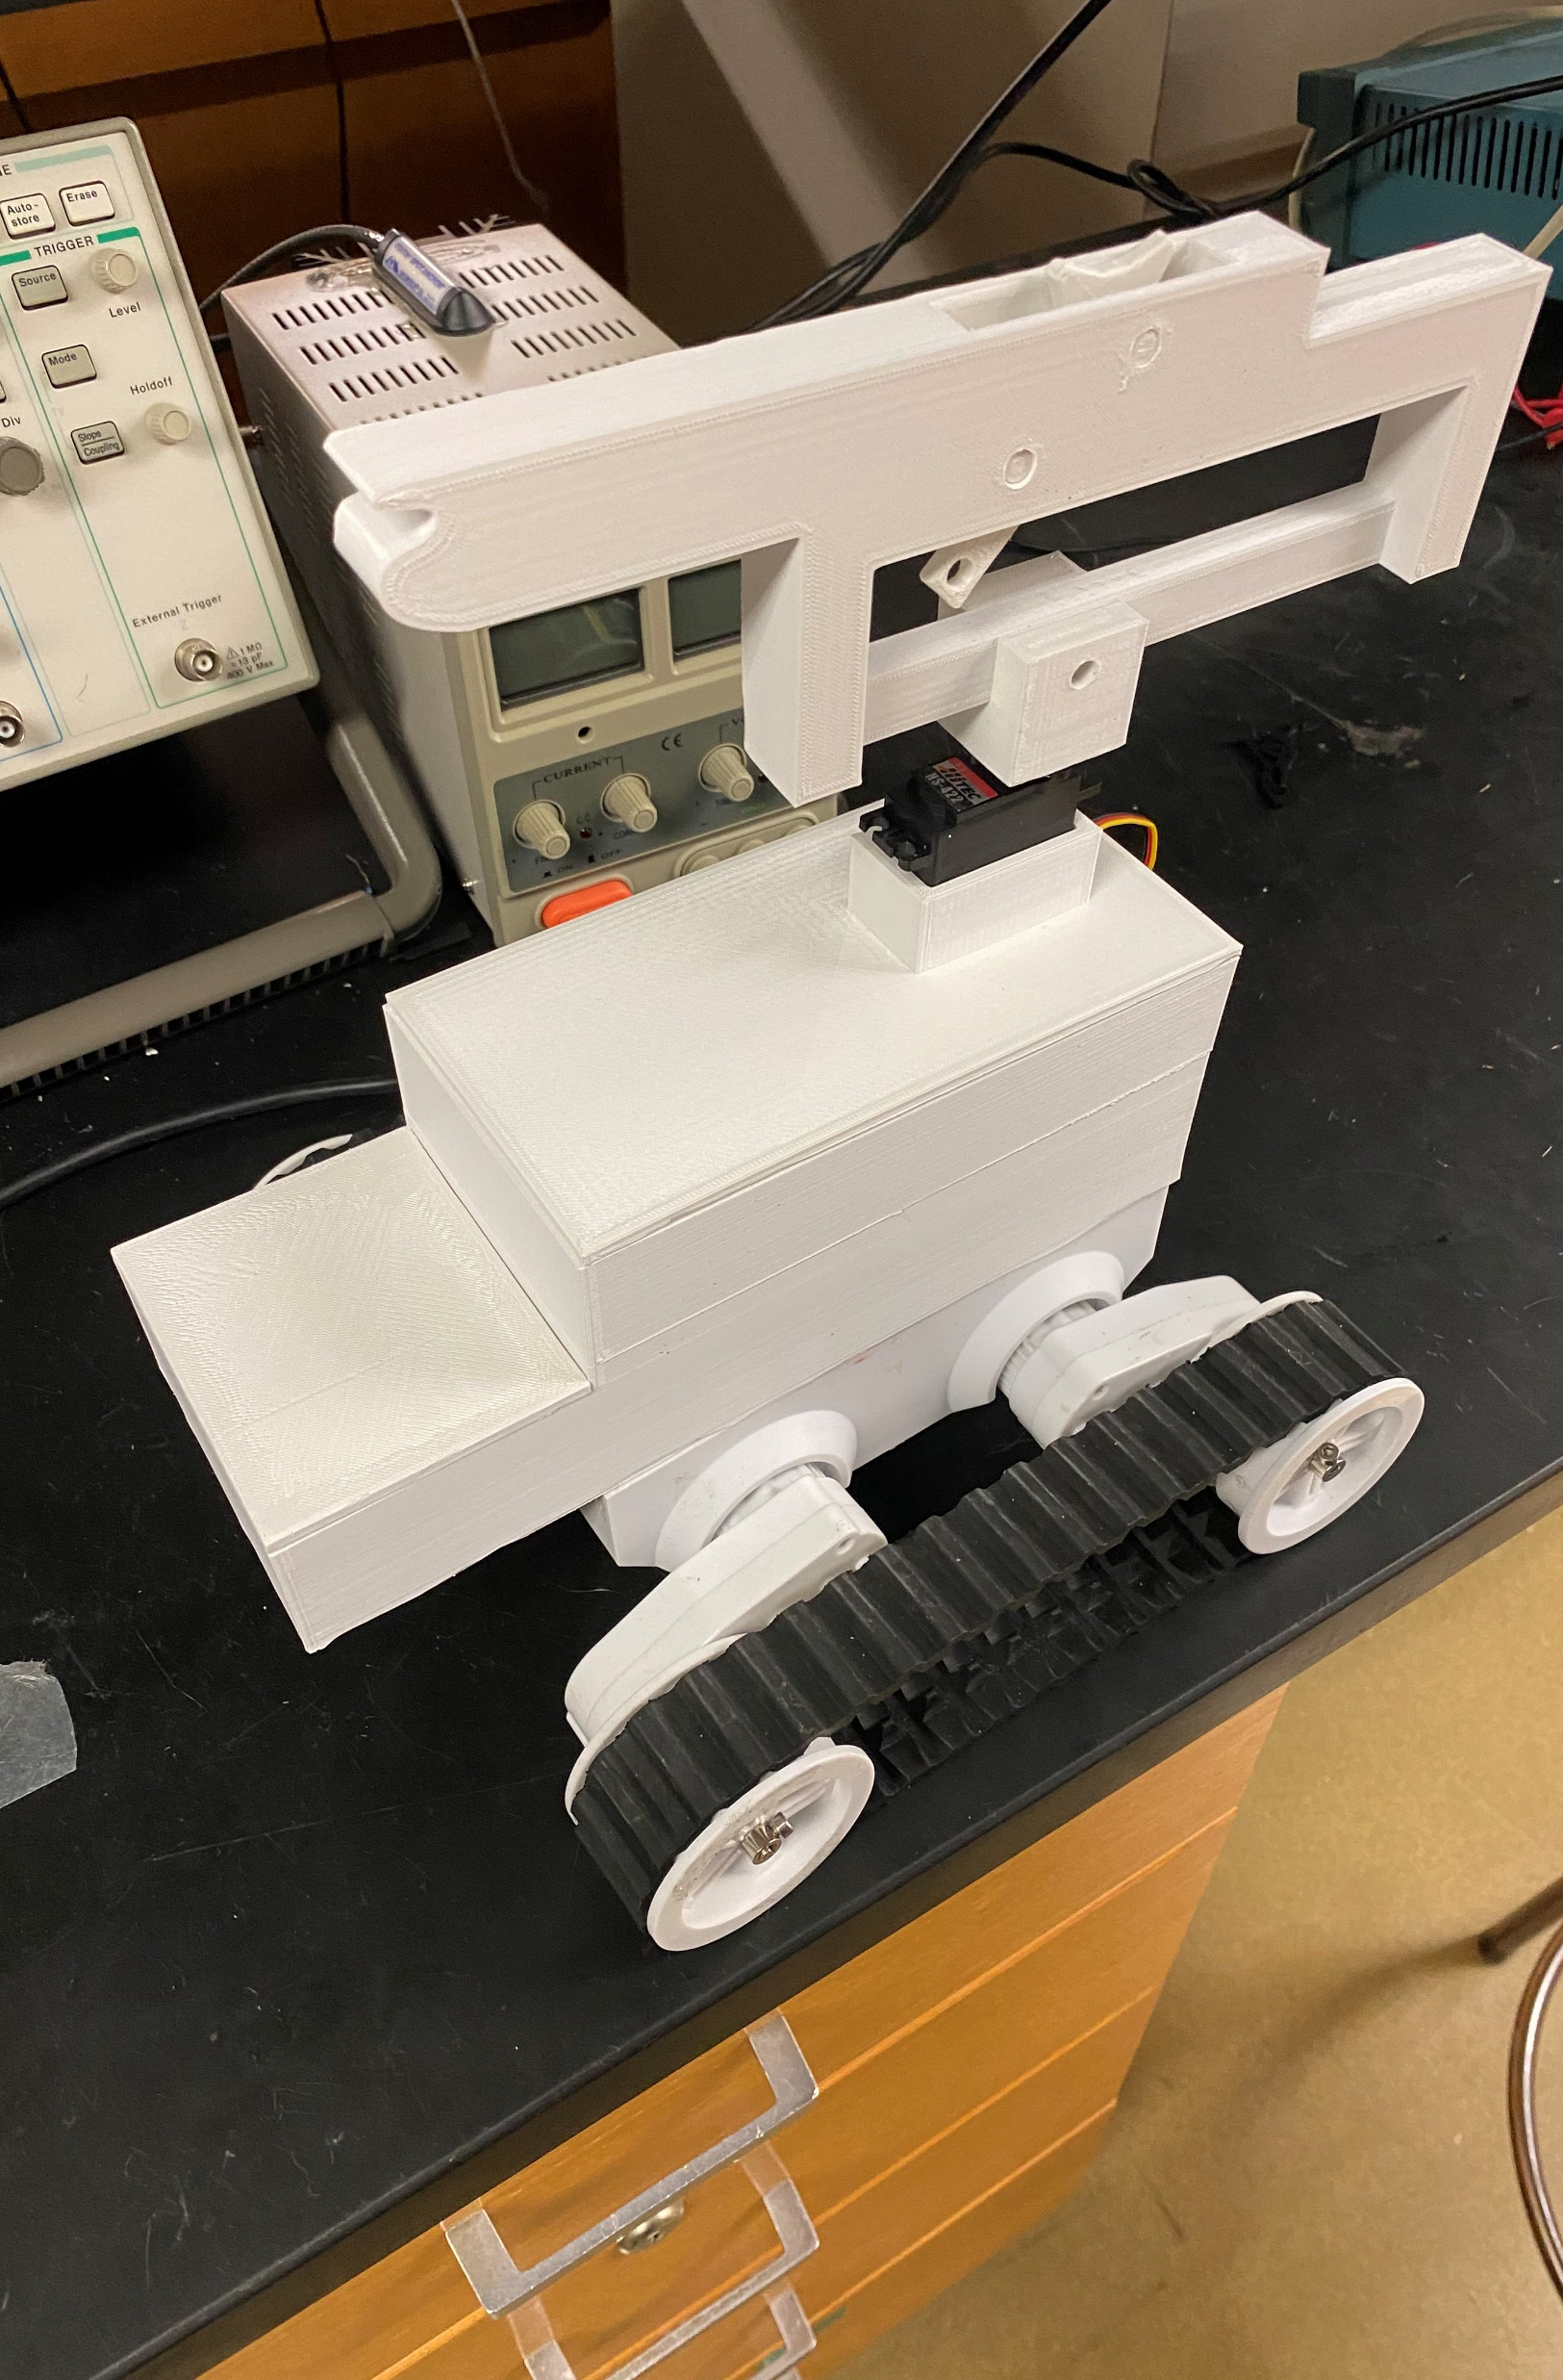
The Project Description & Objectives
Using a BASYS board, H bridge board and sensors to make a rover move along a metallic path and identify friendlies and hostiles along its path while also shooting the enemies by firing rubber bands at them

Slide 3
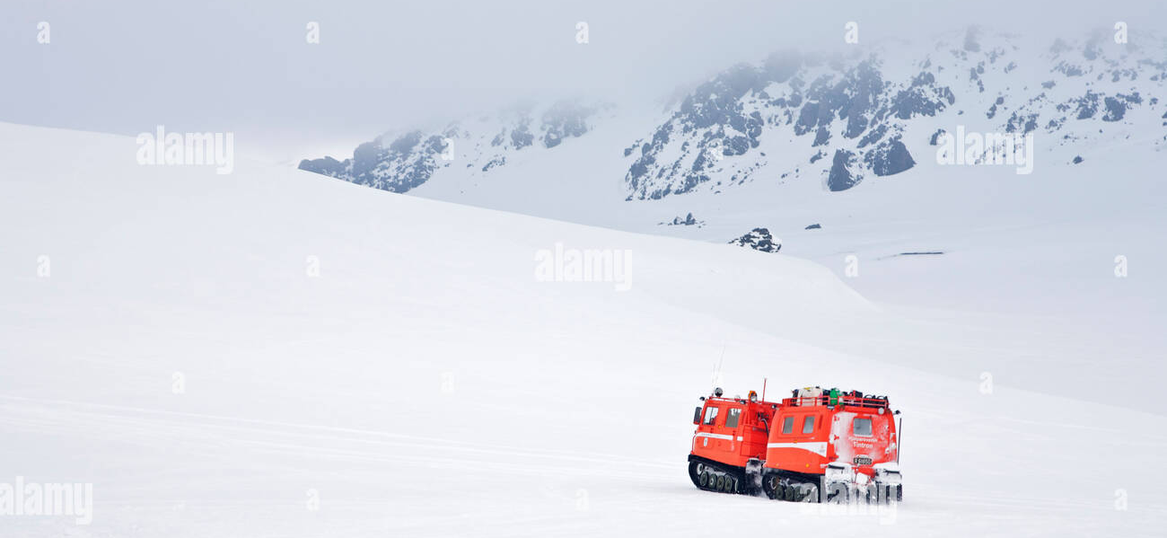
Project Opportunity
Search & Rescue: The rover could be modified to help in search and rescue operations by following a certain path in difficult terrains like snow. It will find people who in danger by making them flash a red light or a flare and detecting that. The gun on top could be replaced with a pointer that points towards the direction of the person in need of help.

Slide 4
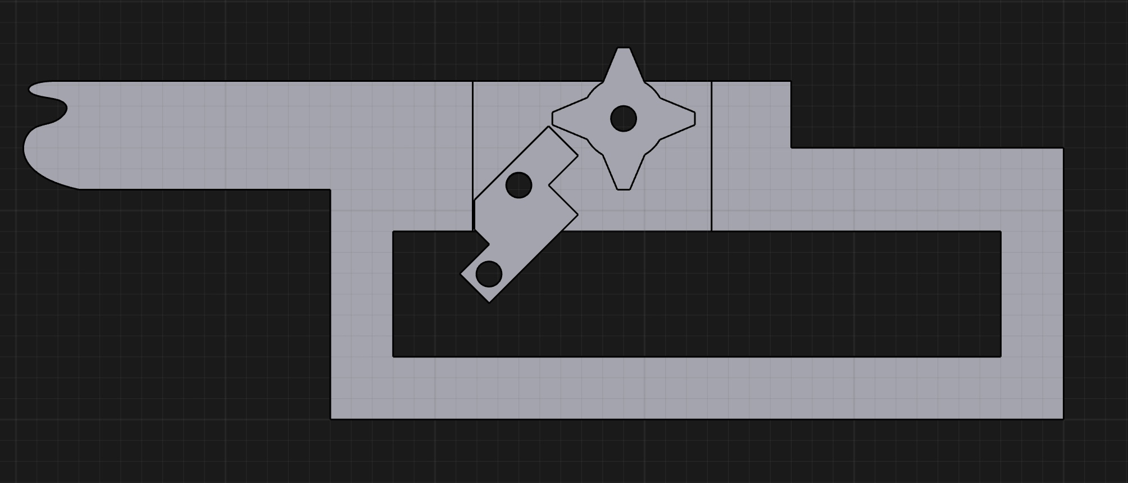
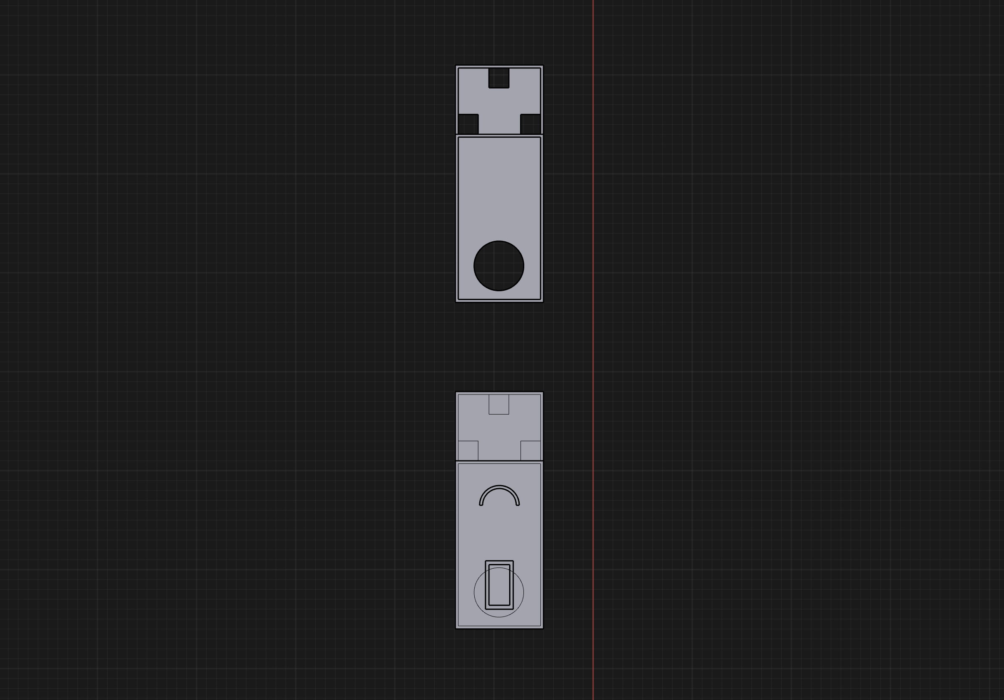
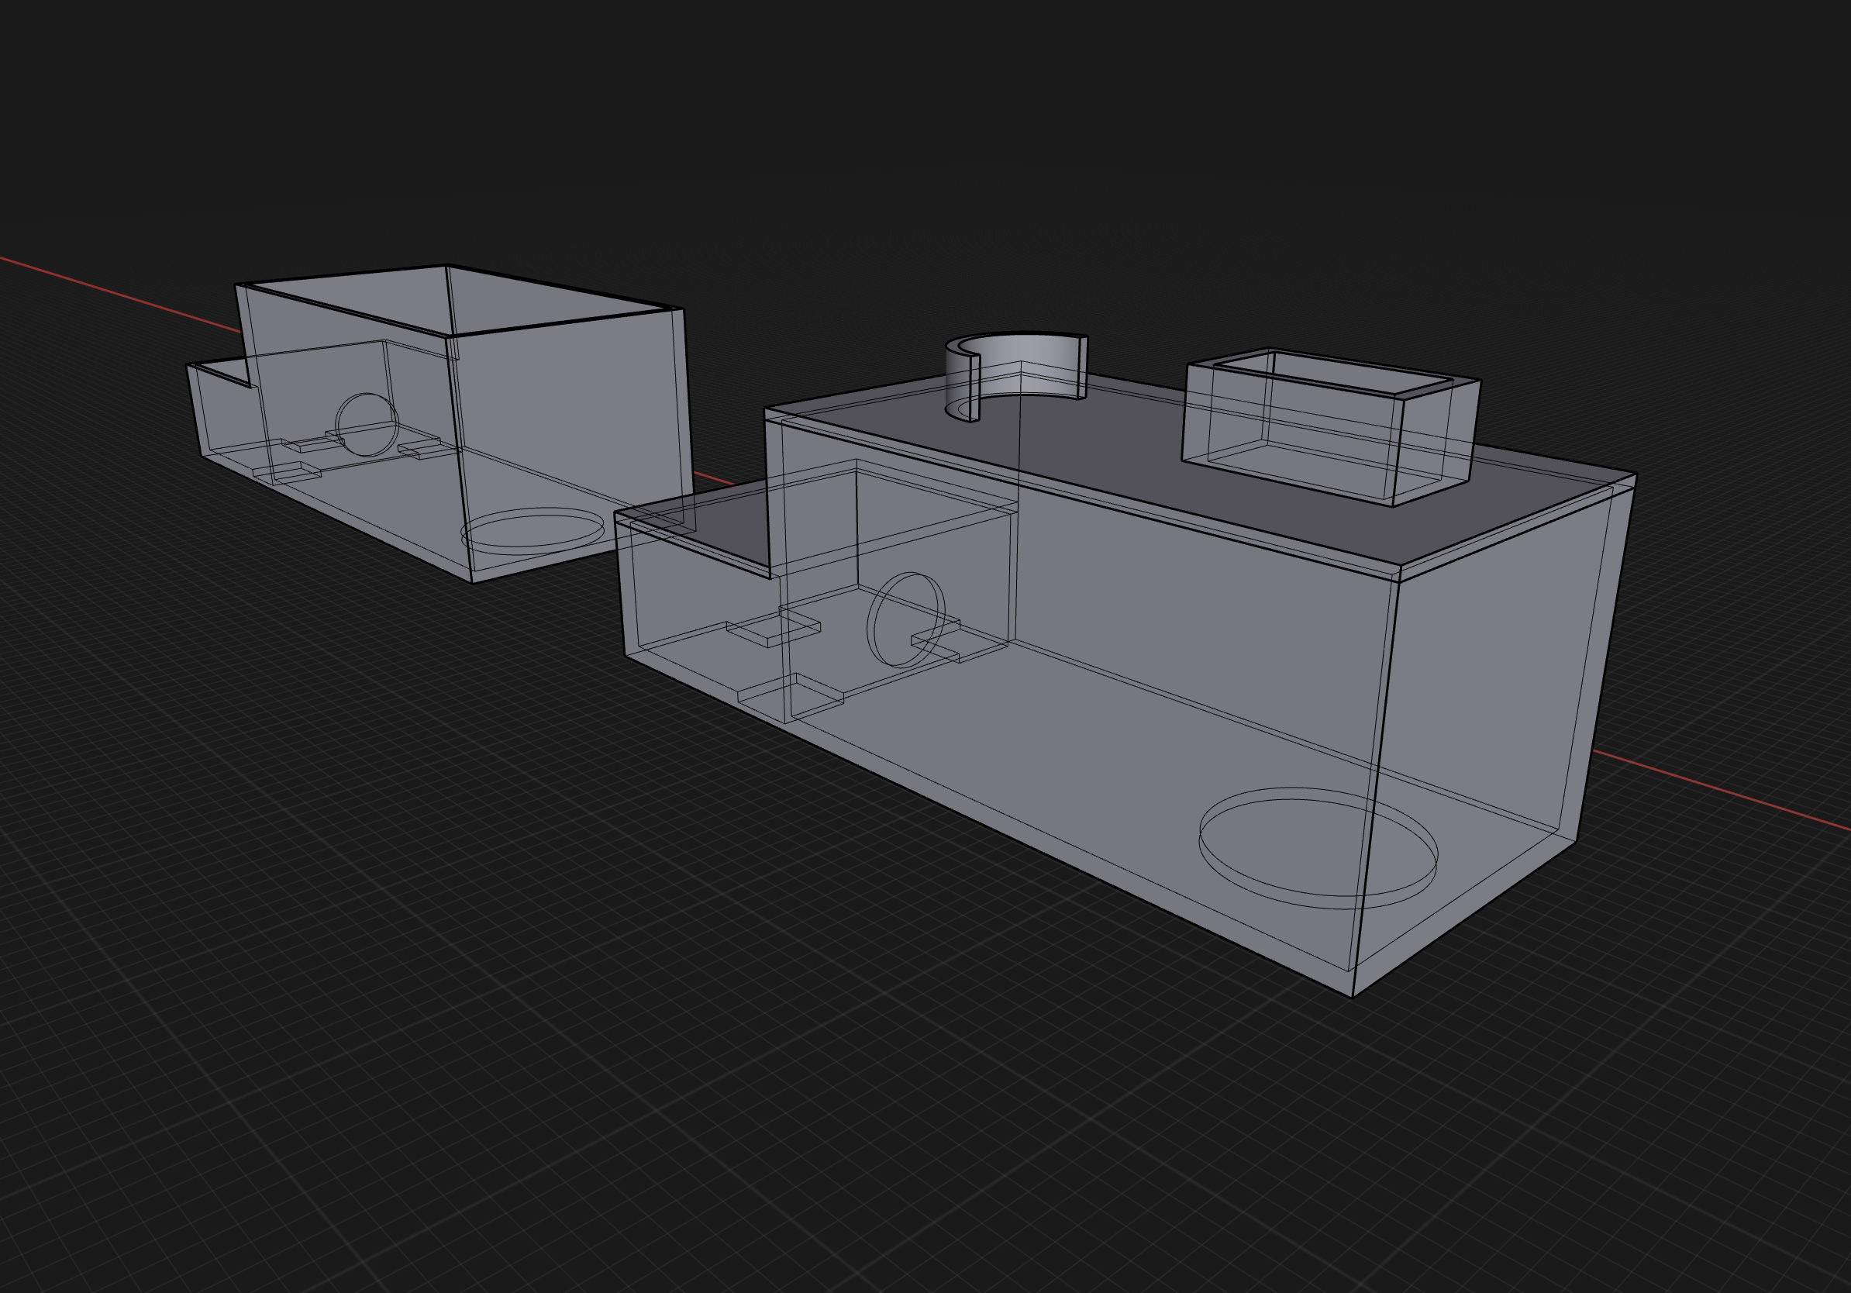
Project Sketch
3D Models for the rover

Slide 5
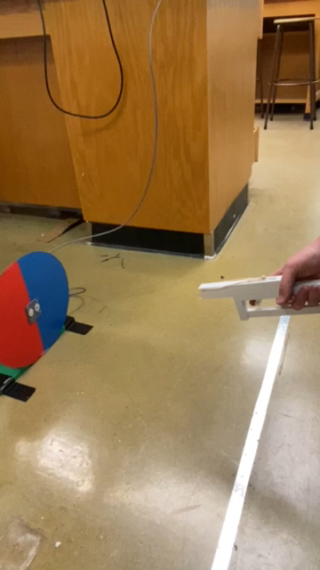
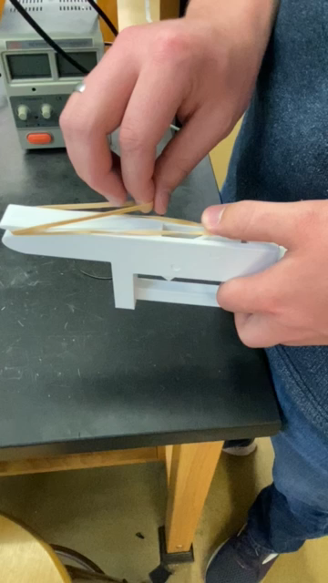
Hardware
Rubber band gun

Slide 6
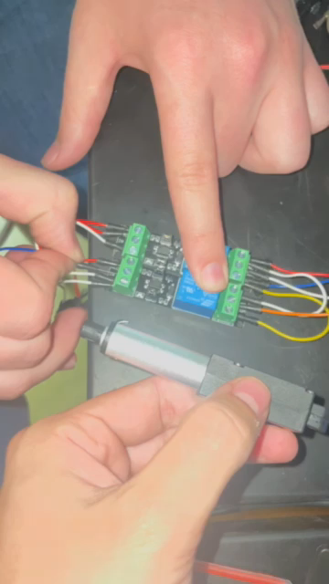
Hardware
Actuator

Slide 7
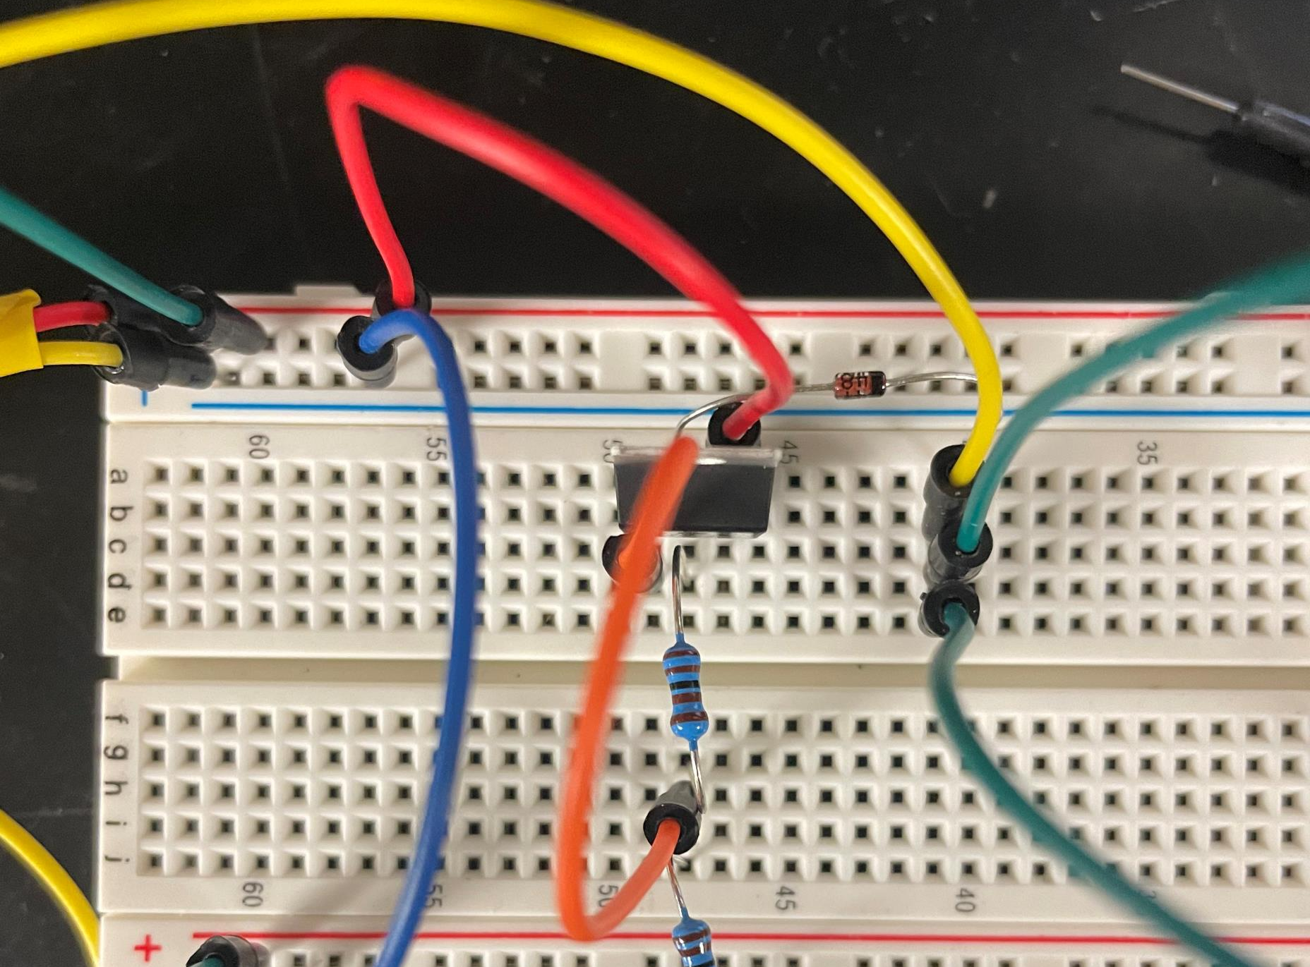
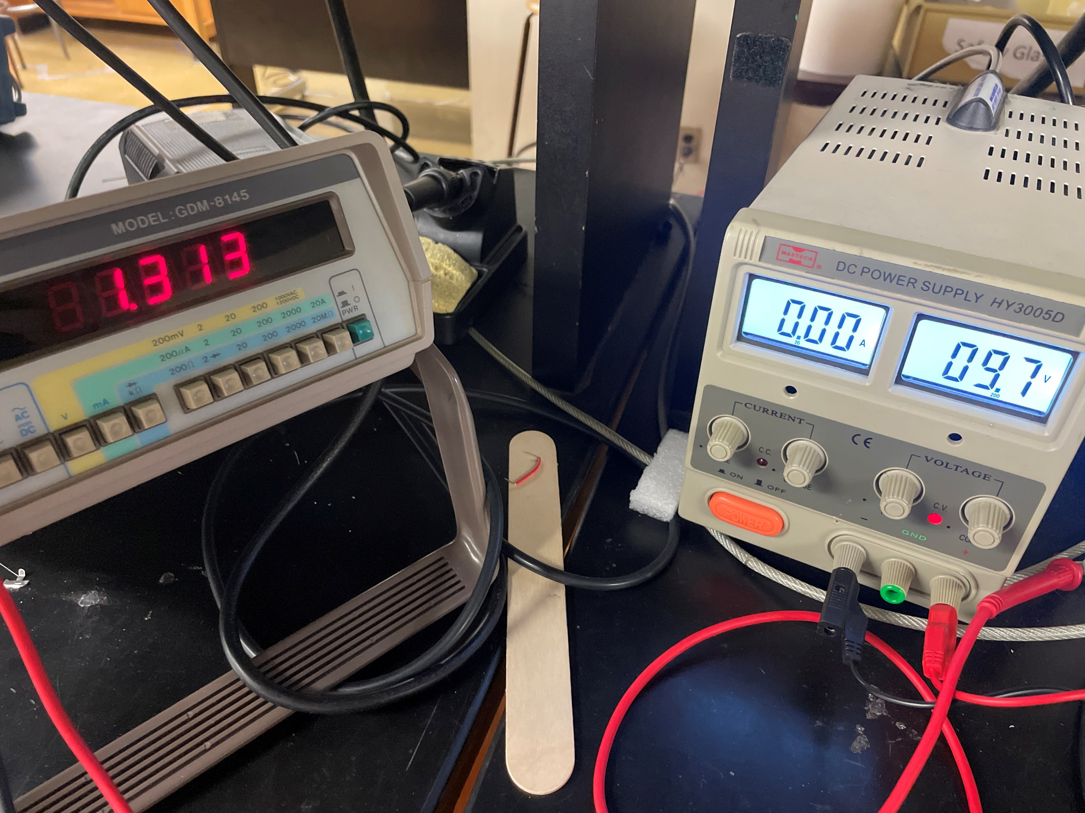
Hardware
1V Regulator

Slide 8
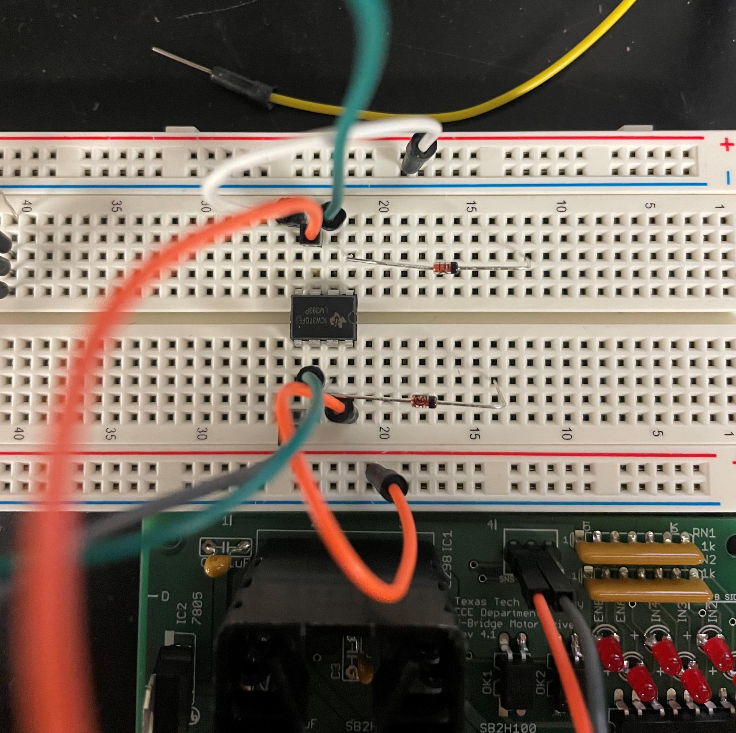
Hardware
Comparator

Slide 9
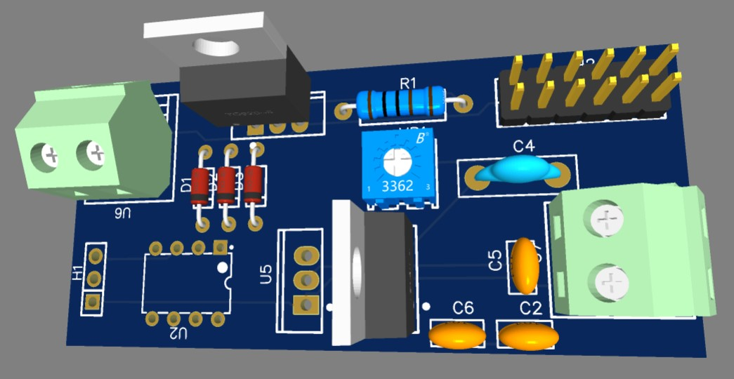
Hardware
3D Model
Decided to mount with double sided tape.
Might need to make some improvements
Traces maybe too thin?
OR gate might be too small to solder
Trim pot will be bypassed with a standard resistor

Slide 10
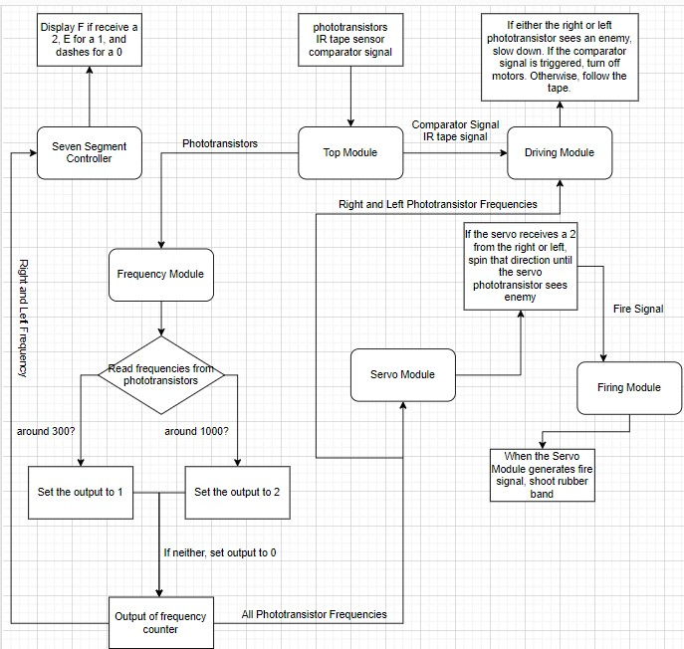
Software
Flow Chart

Slide 11
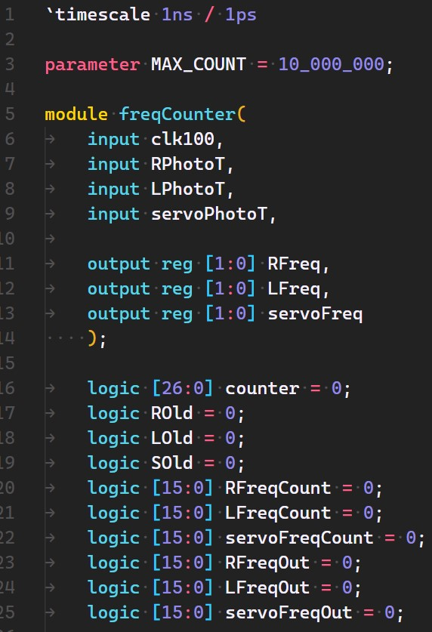
Software
Frequency Counter - Initialization

Slide 12
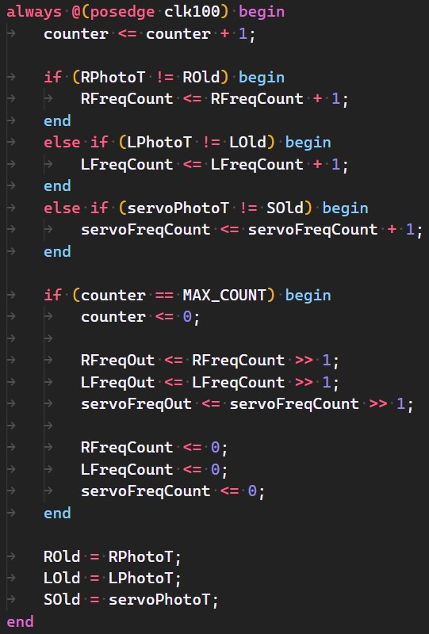
Software
Frequency Counter - Logic

Slide 13
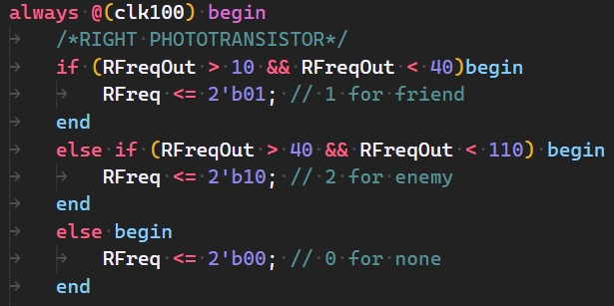
Software
Frequency Counter - Output

Slide 14
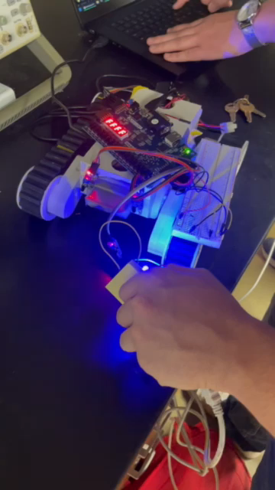
Software
Frequency Tied with Other Modules

Slide 15
Gantt Chart

Slide 16
Overall Budget

Slide 17
Labor Hours and Material costs

Slide 18

Questions
Software Manager: Dirk Thieme
Hardware Manager: Erik Manis
Project Controller: Mohammed Ansari
This Photo by Unknown author is licensed under CC BY.

